Slide 1
Project Title: Building Linux Distribution with Clang/LLVM
SUBMITTED BY
HARSHIT GUPTA(240840130010)
GAUTAM BHADORIA(240840130008)
SUMEET JAT(240840130042)
RUTUJA SANDBHOR(240840130034)
LALIT DEOKAR(240840130018)

Slide 2
Table of content
Introduction
Problem Statement
Objectives
Methodology
GCC
Clang/LLVM
Hardware Requirements
Software Requirements
Challenges and Limitations
Conclusion

Slide 3
Introduction
This project explores compiling the Linux kernel with Clang/LLVM instead of GCC, analyzing feasibility, performance, and compatibility. While Clang offers benefits like better optimization and faster builds, challenges remain in kernel compatibility and debugging. The study tests Clang-built kernels on ARM and RISC-V, comparing compilation time, binary size, and execution speed against GCC. If successful, this transition could enhance cross-platform support and debugging. The findings will help developers assess Clang/LLVM as a viable alternative for Linux kernel compilation and contribute to future improvements in compiler technology.

Slide 4
Problem Statement
This project explores compiling the Linux kernel with Clang/LLVM instead of GCC, analyzing feasibility, performance, and compatibility. While Clang offers benefits like better optimization and faster builds, challenges remain in kernel compatibility and debugging. The study tests Clang-built kernels on ARM and RISC-V, comparing compilation time, binary size, and execution speed against GCC. If successful, this transition could enhance cross-platform support and debugging. The findings will help developers assess Clang/LLVM as a viable alternative for Linux kernel compilation and contribute to future improvements in compiler technology.

Slide 5
Objectives
This project explores compiling the Linux kernel with Clang/LLVM instead of GCC, analyzing compatibility, performance, and challenges.
It evaluates Clang/LLVM-compiled kernels on ARM and RISC-V, measuring build time, execution speed, and memory use. Additionally,
it documents the setup, issues, and solutions to aid developers in adopting Clang/LLVM for kernel development.

Slide 6
Methodology
Step 1: Set up the build environment (install Clang, LLVM, and necessary dependencies).
Step 2: Configure and compile the Linux kernel using Clang/LLVM.
Step 3: Test the compiled kernel on ARM and RISC-V architectures.
Step 4: Analyze performance metrics and compare results with GCC. Step 5: Document findings and challenges.

Slide 7
GCC
GCC has been the primary compiler for the Linux kernel, offering robust optimizations, inline assembly support, stable ABI, and wide architecture compatibility. It integrates seamlessly with Kbuild but has drawbacks like longer compilation times and less detailed diagnostics.

Slide 8
Clang/LLVM
Clang provides faster compilation, better error diagnostics, advanced optimizations, modular design, and improved debugging tools. It supports LTO, GCC compatibility, and has a permissive license.

Slide 9
Difference Between GCC and Clang/LLVM Utilities
Utility | GCC | Clang/LLVM
Compiler | gcc | clang
Assembler | as | llvm-as
Linker | ld | lld
Object Dump | objdump | llvm-objdump
Disassembler | objdump -d | llvm-dis

Slide 10
Hardware Requirements
● Processor: Multi-core processor (ARM or RISC-V, depending on the target architecture)
● Memory (RAM): At least 8GB (16GB or more recommended for large kernel builds)
● Storage: Minimum 50GB of free disk space (kernel source, build artifacts, and logs require significant space)

Slide 11
Software Requirements
● Operating System: A modern Linux distribution (Ubuntu, Debian, Fedora, or Arch Linux recommended)
● Kernel Version: Running a Linux system with kernel version 4.x or later for better Clang/LLVM compatibility
● Development Tools: Basic development utilities such as make, ninja, cmake, git, and bash
● Dependencies: Required libraries for building the kernel (listed in the installation steps below)

Slide 12
Install Clang/LLVM
Update System: sudo apt update && sudo apt upgrade -y
Install Clang/LLVM
sudo apt install -y clang lld llvm llvm-dev
Install Kernel Build Dependencies
sudo apt install -y cmake ninja-build clang gcc g++ python3 zlib1g-dev \
lldb libxml2-dev libncurses5-dev binutils gdb lld libstdc++-dev valgrind \
libedit-dev libffi-dev swig u-boot-tools device-tree-compiler bc flex \
bison libssl-dev cpio python3-distutils

Slide 13
Install Clang/LLVM
make ARCH=arm CROSS_COMPILE=arm_linux_llvm- LLVM=1 HOSTCC=clang CC=clang versatile_defconfig2.
make ARCH=arm CROSS_COMPILE=arm_linux_llvm- LLVM=1 HOSTCC=clang CC=clang menuconfig3.
make ARCH=arm CROSS_COMPILE=arm_linux_llvm- LLVM=1 HOSTCC=clang CC=clang -j($nproc)

Slide 14
Install Clang/LLVM
make ARCH=arm CROSS_COMPILE=arm_linux_llvm- LLVM=1 HOSTCC=clang CC=clang versatile_defconfig2.
make ARCH=arm CROSS_COMPILE=arm_linux_llvm- LLVM=1 HOSTCC=clang CC=clang menuconfig3.
make ARCH=arm CROSS_COMPILE=arm_linux_llvm- LLVM=1 HOSTCC=clang CC=clang -j($nproc)

Slide 15
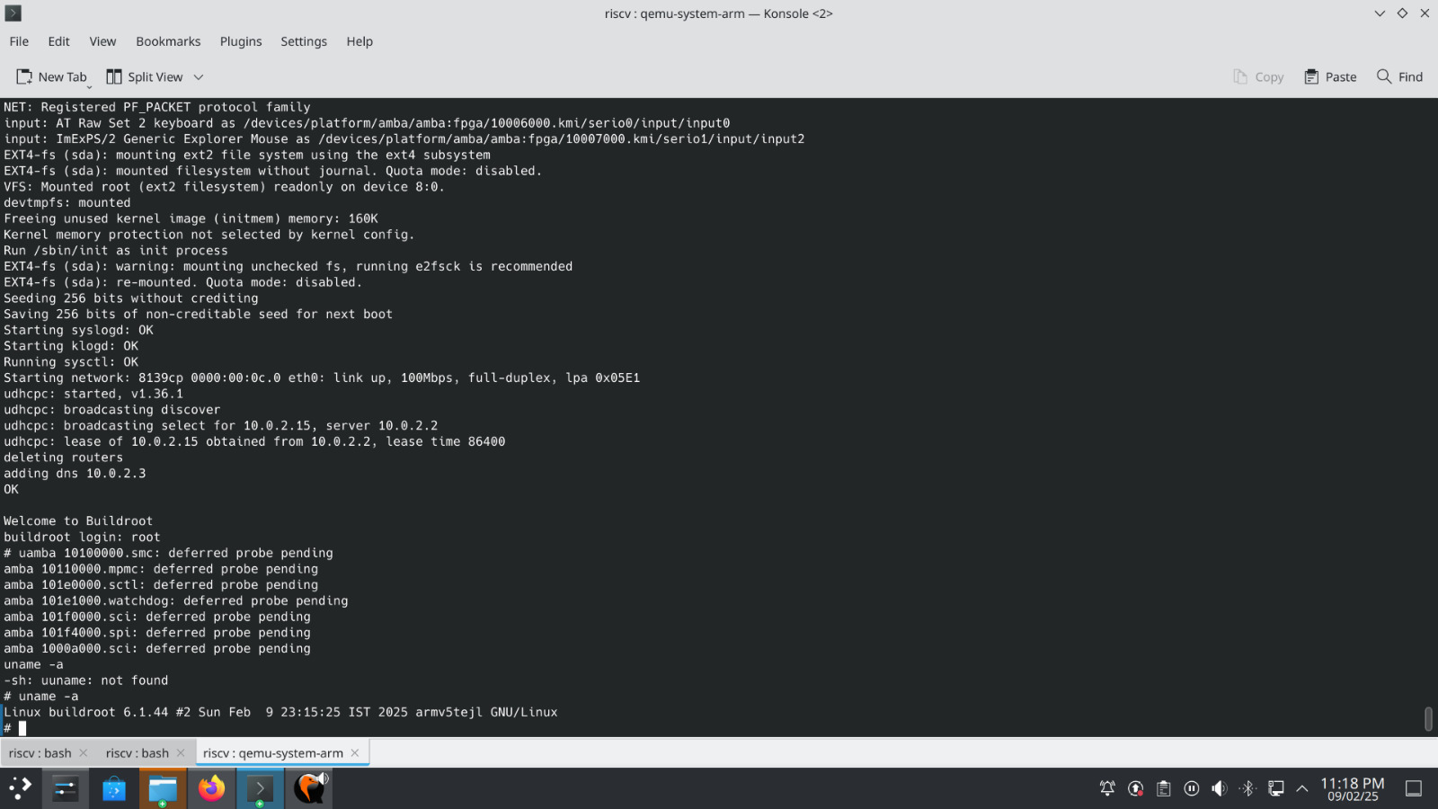
Install Clang/LLVM

Slide 16
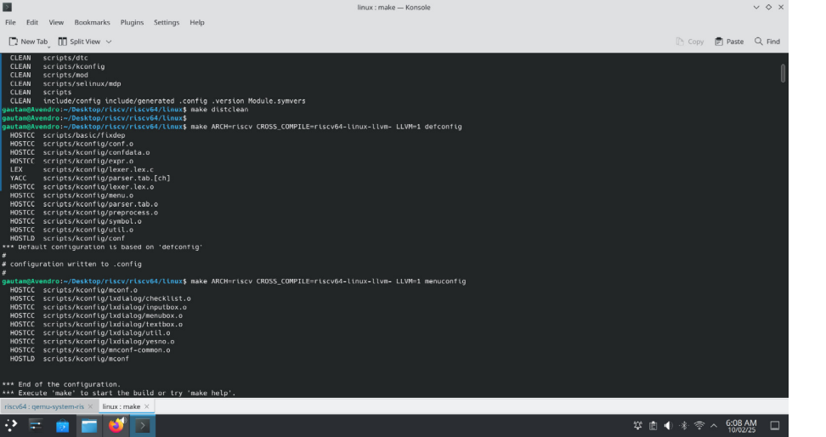

Slide 17
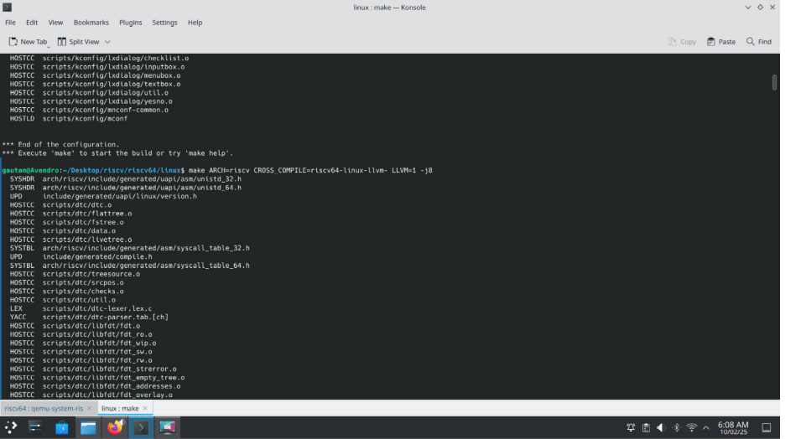

Slide 18
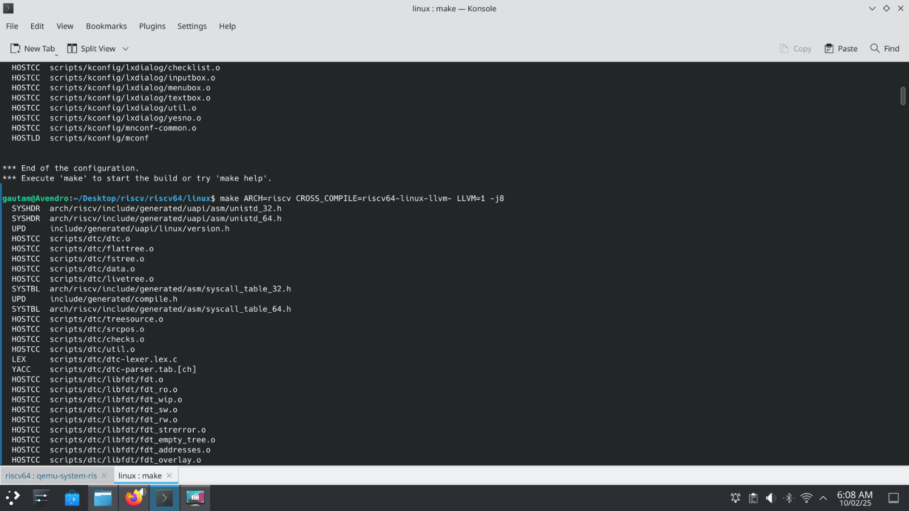

Slide 20
Challenges and Limitations
Compatibility Issues – Kernel code is optimized for GCC, requiring updates for Clang.
Performance Variations – Clang may cause regressions in some workloads.
Debugging Complexity – Optimization differences create subtle issues.
Toolchain Changes – Switching requires build and workflow modifications.
Architecture Gaps – Some architectures lack full Clang support.

Slide 21
Conclusion
Compiling the Linux kernel with Clang/LLVM offers advantages like faster builds, better diagnostics, and modern optimizations. However, challenges remain, including compatibility issues, performance variations, and toolchain integration. While Clang is increasingly adopted, continued collaboration between the Linux and LLVM communities is essential to ensure stability and efficiency.

Slide 22
Thank you!

